Slide 1
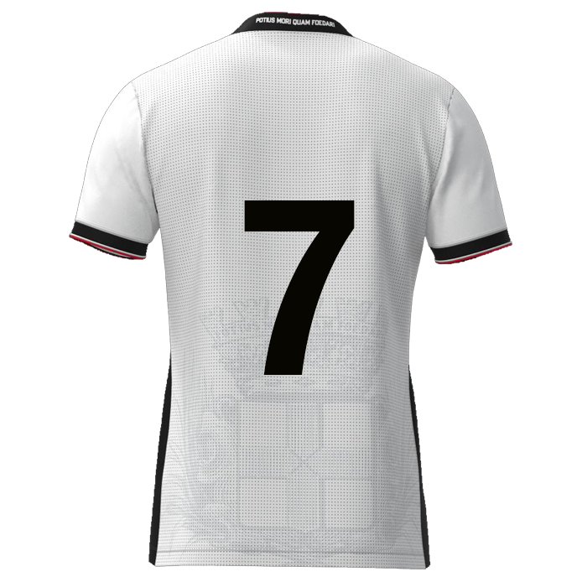
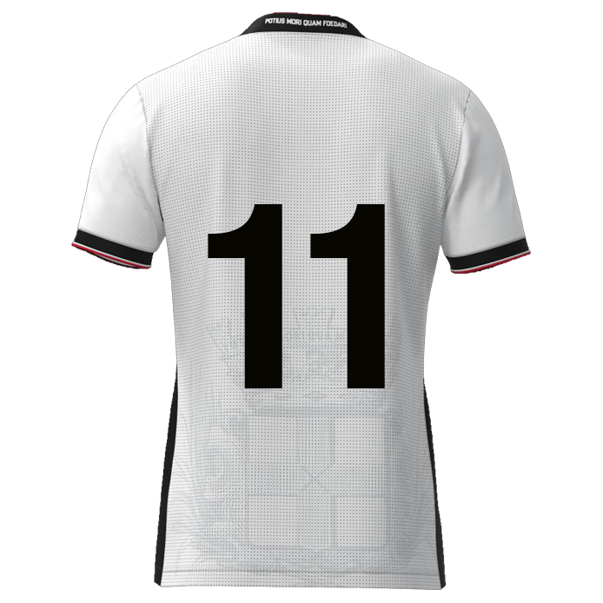

Slide 2

Browse
Foto
DATE: DD-MM-JJJJ
Player name
DD/MM/YYYY: Game / Training
DD/MM/YYYY: Game / Training
DD/MM/YYYY: Game / Training
DD/MM/YYYY: Game / Training
DD/MM/YYYY: Game / Training
DD/MM/YYYY: Game / Training
DD/MM/YYYY: Game / Training
Dribbling past opponent
xx
xx%
Composure
Crosses
Shooting from distance
Agility
Speed
Flair
Bravery
xxxx
Dribbling winger nr. 07 & 11
9
11
7
xxxx
8
10
6
xxxx
xx
xx
xx
xx
5
2
4
3
xxxx
1
xxxx

Slide 3
DW #7 | Rating | Vermenigvuldigingsfactor | Resultaat
Dribbling past opponent | 0 | 1,1 | 0
Composure | 0 | 1,1 | 0
Crosses | 0 | 1 | 0
Shooting from distance | 0 | 1 | 0
Agility | 0 | 1,1 | 0
Speed | 0 | 1 | 0
Flair | 0 | 1,1 | 0
Bravery | 0 | 1 | 0
 |  | Gemiddelde rating | 0,00

Slide 4
Dribbling winger #07 #11
9
11
7
Dribbling past opponent
Agility
Flair
10
8
Composure
6
5
2
4
3
CROSSES
Speed
Bravery
1
Shooting from distance

Slide 5
Dribbling past opponent
Composure
Crosses
Shooting from distance
“Dribble resulting a duel, after which player remains in possession, resulting in >5m forwards displacement”
“Calm and controlled under
pressure, to make good decisions
and execute skills accurately”
“Open play pass, from outside the score box in the flank zones in the final third, into the central zone of the score box”
“Shot from open play from
outside the score box”
Tricks
Power or speed
Inside - outside
Timing
Combination play
Frequency?
End result
?
Danger zones
Overview
(Body)position
Goal oriented
Goal attempts
Between the posts
End result
?
Overview
End location
Cross location
Type of cross
Preparation
Frequency?
End result
?
Type of shot
Short or deep angle
Power
Preparation
Frequency
End result
?
Agility
Speed
Flair
Bravery
“Quickly change direction, accelerate, and control body movement while maintaining balance”
“Ability and confidence to perform creative, skillful, and often unexpected actions with the ball”
“The willingness to face physical challenges, difficult situations, or potential contact without fear”
“Top speed and acceleration capabilities”
Reaction speed
Footwork
Balance
Center of gravity
Change of direction
Mobility
?
Top speed
Acceleration
Stride length
Big / small distance
First meters
End result
?
Appearance
Confident
Present
In control
Excited
Boost at heat of the moment
?
Initiative
Taking risks
Freedom
Surprising
Creativity
Confident after mistakes
?

Slide 6



Slide 8
Crosses

Slide 9
Shooting
from distance

